Slide 1
Understanding and extracting useful features
Part I

Slide 2
Review: Training Data
Data used to “train” a machine learning model
Training datasets are fed to machine learning algorithms to teach them how to make predictions or perform a desired task.
We’ve also used this in LinearRegression
We train a regression model with known x,y values so that it can attempt to predict missing y values

Slide 3
Validation Data
Data that is used to evaluate the an ML model

Slide 4
Validation Data
Note: The validation data IS PART of the training.
The ML model needs to learn and adjust it’s predictions on data for which it has not “seen” yet (aka: been trained with).

Slide 5
Test Data
Once your machine learning model is built (with your training data), you need unseen data to test your model.
You can use it to evaluate the performance and progress of your algorithms' training and adjust or optimize it for improved results
Final, real-world check of an unseen dataset to confirm that the ML algorithm was trained effectively.

Slide 6
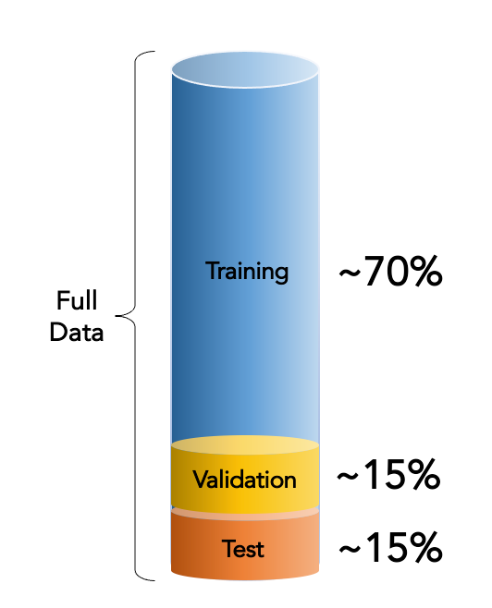
Dividing Data
You can divide single data sets into training, validation, and test data
There can also be multiple training/validation phases

Slide 7
Weights
A number or coefficient that describes the impact of a feature
In different ML models, weights are assigned differently. They can even change in different parts of the model.

Slide 8
Bias
The error between average model prediction and the ground truth
Formally: An error from erroneous assumptions in the learning algorithm
What does it really mean: Assumptions made by a model to make a the data easier to understand and therefore make it easier to train the model

Slide 9
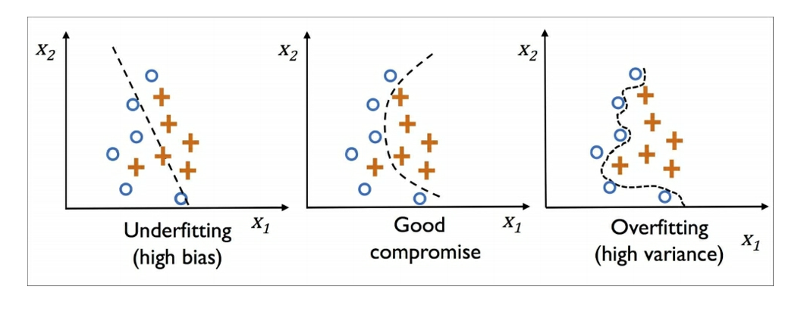
Bias
In this diagram, we’re trying to find a good line-of best fit that would classify a value (x,y) into either a “circle” or “plus” symbol.
If our line of best fit has high bias, we will not get a very accurate prediction
The model doesn’t perform well on the training set

Slide 10
Variance
Measures the consistency (or variability) of the model prediction for a particular sample instance if we were to retrain the model multiple times, for example, on different subsets of the training set
The goal of a ML model is to find connections and correlations between features in order to predict an outcome.
If a model has high variance, it cannot capture the underlying trend of the data

Slide 11
Variance
In this diagram, we’re trying to find a good line-of best fit that would classify a value (x,y) into either a “circle” or “plus” symbol.
If the line of best fit has high variance, we will get too precise a prediction
The line represents the training set very well, but would not perform well on a test dataset

Slide 12
Overfitting
It a model performs better on the training dataset than the test dataset, this is called overfitting.
The model fits the parameters too closely with regard to the particular observations in the dataset but does not well generalize to new data
Basically, the model is not generalized enough and is too complex.

Slide 13
Tackling Overfitting
Collect more training data
Introduce a penalty for complexity via regularization
Choose a simpler model with fewers parameters
Reduce the dimensionality of the data

Slide 14
Tackling Overfitting: Collecting more training data
This usually isn’t applicable. If we had more training data, we would have already used it

Slide 15
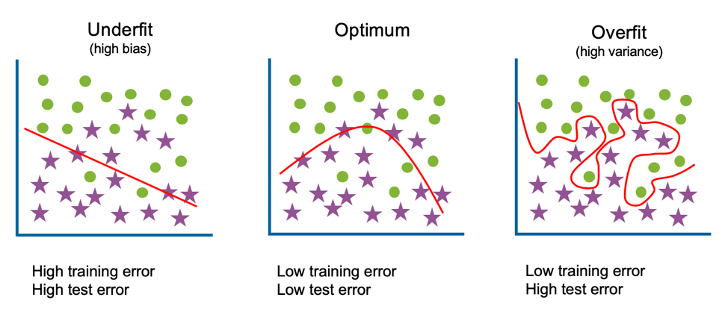
Tackling Overfitting: Regularization
Concept: introduce additional information (bias) to penalize extreme parameter (weight) values
Notice in this overfitting example, the line-of-best-fit is attempting to include the star and circle outliers

Slide 16
Tackling Overfitting: L2 Regularization
L2 regularization introduces bias by “adding a penalty which is equal to the sum of the square of the magnitude of coefficients.”
What does this mean?
Adding a penalty = decreasing the weight (aka feature impact)
square of the magnitude = the absolute value of the coefficients squared
coefficients in ML are “weights”
It decreases the impact of features based the total impact of features

Slide 17

L2 Regularization
Here’s the formula for regularization:
w_{n} where “w” is the weight of feature “n”

Slide 18
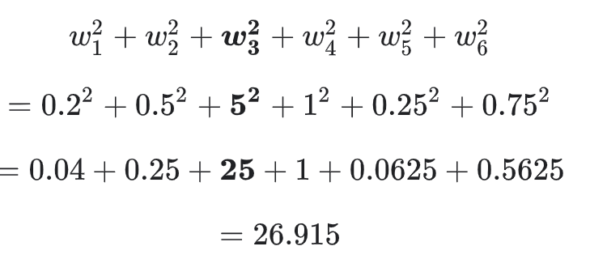
L2 Regularization
let’s say we have the following weights for features 1-6

Slide 19
L2 Regularization
Note that when we adjust the weights, it cannot be negative (the lowest it can go is zero)
Note feature 3 has the highest impact and, therefore, will be most impacted by the penalty

Slide 20
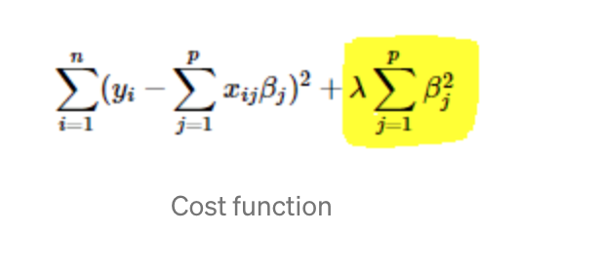
L2 Regularization
We multiply the regularization term (which in the previous example is equal to 26.915) by the regularization parameter to denote our total penalty
The regularization parameter is is commonly denoted with a lambda symbol (𝝀)

Slide 21
Note: Cost Function
The cost function adjust for the error when trying to algorithms predict values (ie: Linear Regression)
The cost function (error plus the penalty) is subtracted from the predicted result
So for Linear Regression, we predict values using
y_prediction = mx+b
Our cost function will adjust the prediction based on error
y_prediction = y_prediction - cost_function
= y_prediction - (error + penalty)
Notes:
https://builtin.com/machine-learning/cost-function

Slide 22
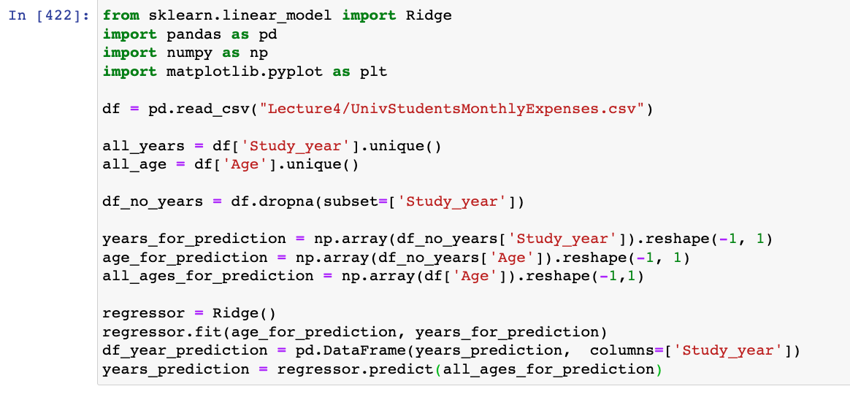
Tackling Overfitting: L2 Regularization
The Ridge function in sklearn to performs linear regression with L2 regularization as the penalty
The Ridge function has a regularization parameter called alpha
Let’s change our code from sklearn - linear regression to use the ridge function instead of linear regression

Slide 23
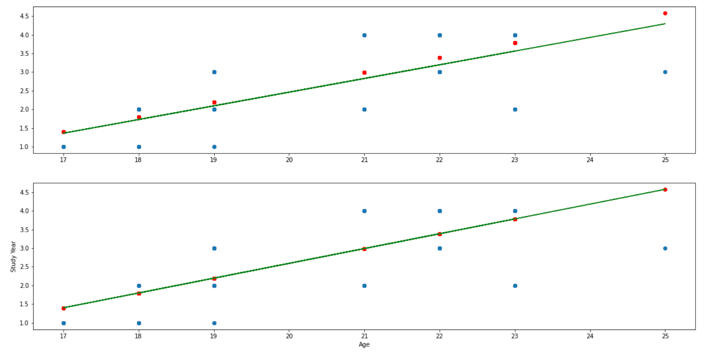
Tackling Overfitting: L2 Regularization
Our line-of-best-fit was already pretty good when using Linear Regression ( LinearRegression() == Ridge() == Ridge(alpha=0))
But now with regularization, it is more tightly fit to the data
In this case, our data didn’t have too many outliers, so this might be underfitting

Slide 24
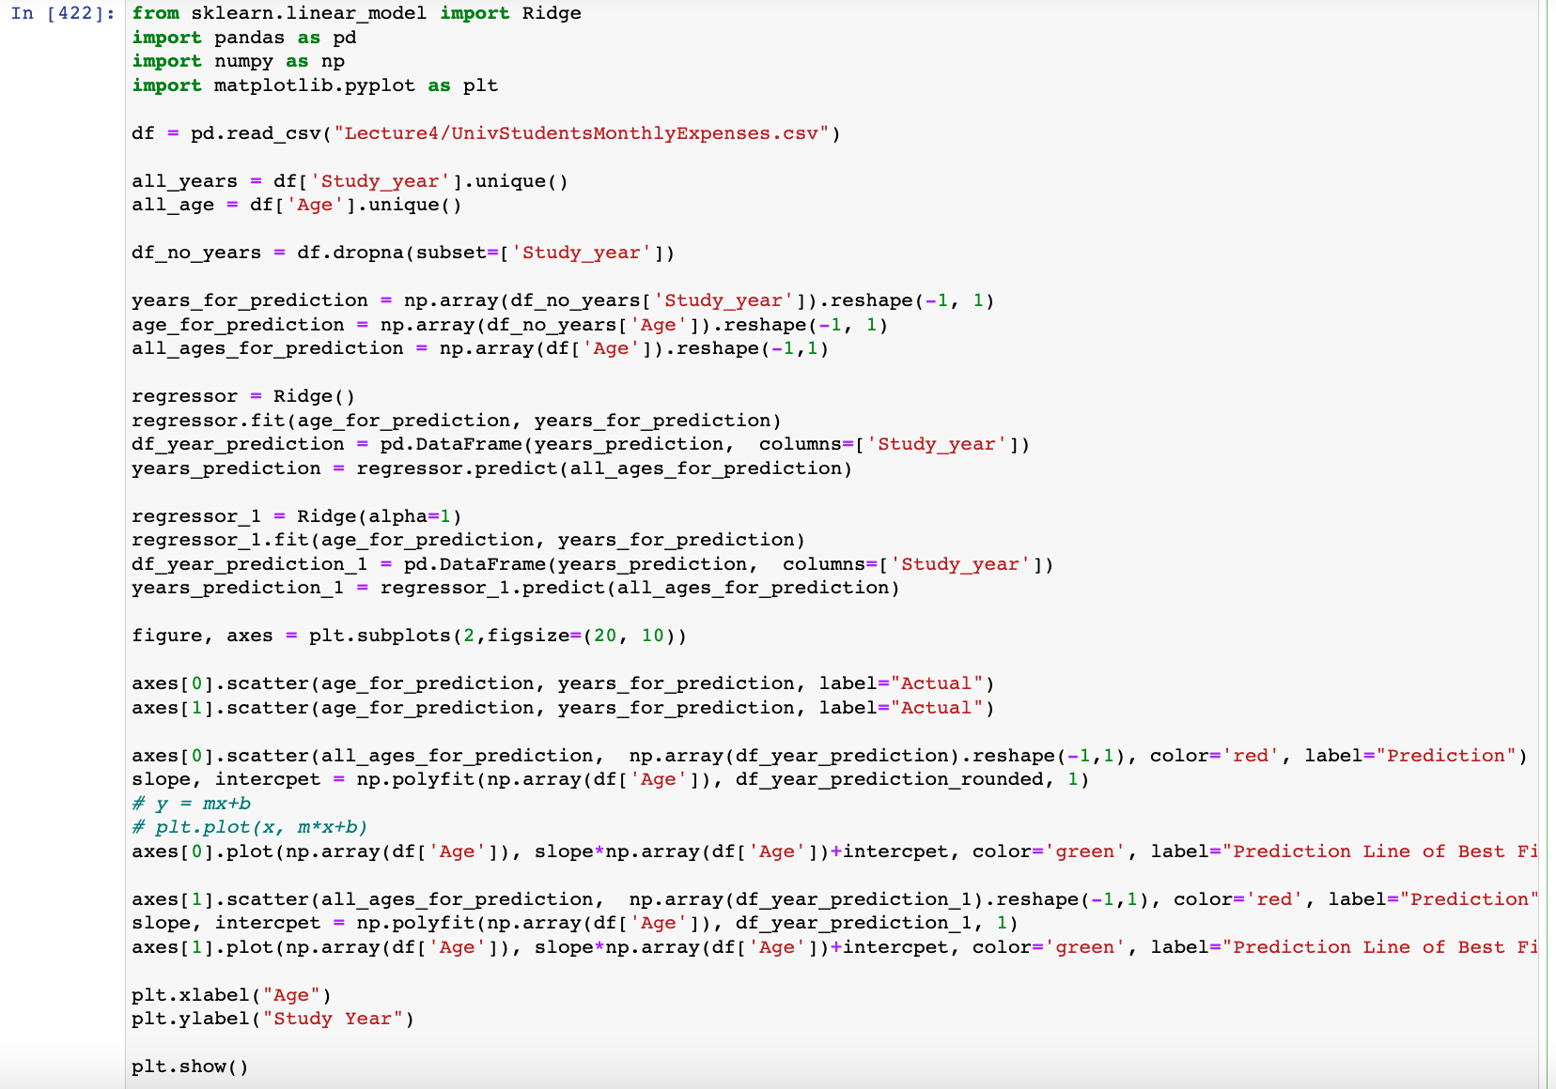

Slide 25
Tackling Overfitting: L1 Regularization
L1 regularization can also be used to tackle overfitting.
Instead of penalizing all the features evenly, it reduces the weight of certain features to zero
This performs feature selection: The process of reducing the number of features into our machine learning algorithm
Less features means the algorithm will be less complex

Slide 26
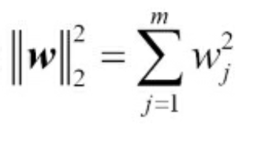
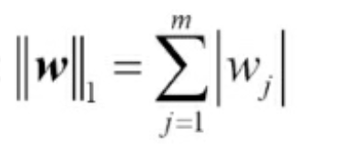
Tackling Overfitting: L1 Regularization
For L1 regularization we just calculate the absolute value of the sum of all the weights instead of the sum of squares
L2 Regularization Parameter
L1 Regularization Parameter

Slide 27
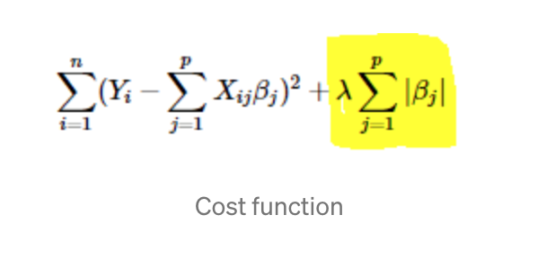
Tackling Overfitting: L1 Regularization
Let’s take the the derivative of each regularization
L2: 2β
L1: k (constant)
This means that every time we predict a value, we are adjusting the error by 2*weight for L2 and a constant value for L1

Slide 28
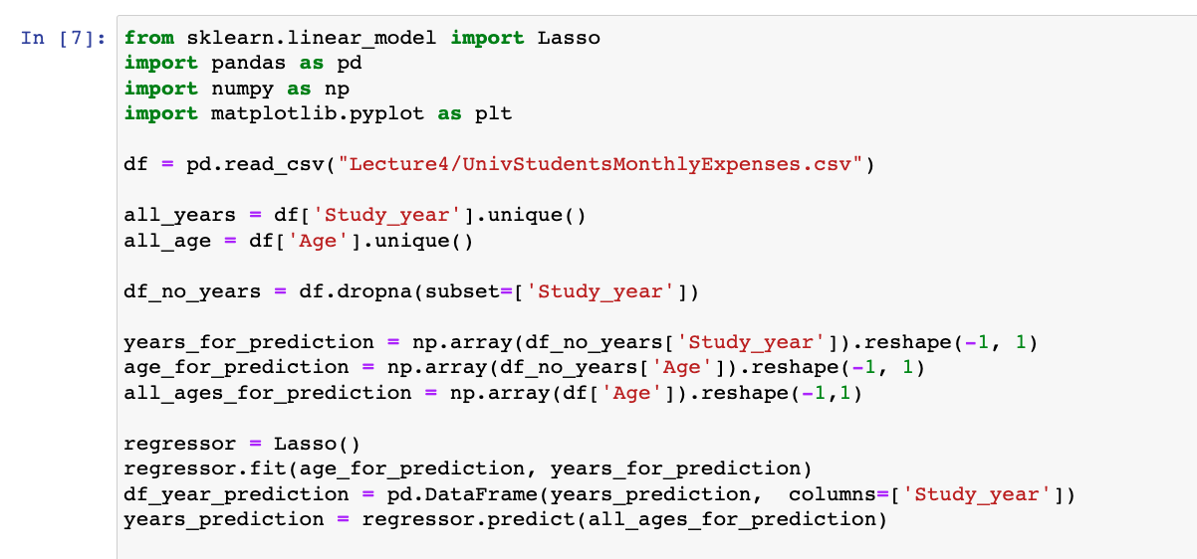
L1 Regularization
In pandas, we use the Lasso function to perform L1 regularization
Let’s change our code from sklearn - linear regression to use the lasso function instead of linear regression

Slide 29
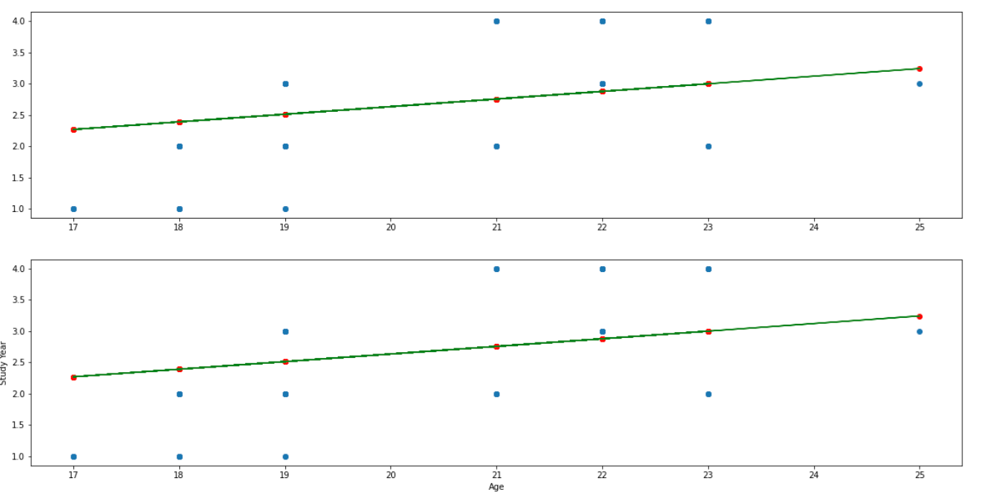
L1 Regularization
In the top graph, we’re using lambda = 0 and in the bottom lambda=1
Notice the bottom graph fits the predicted data slightly better

Slide 30
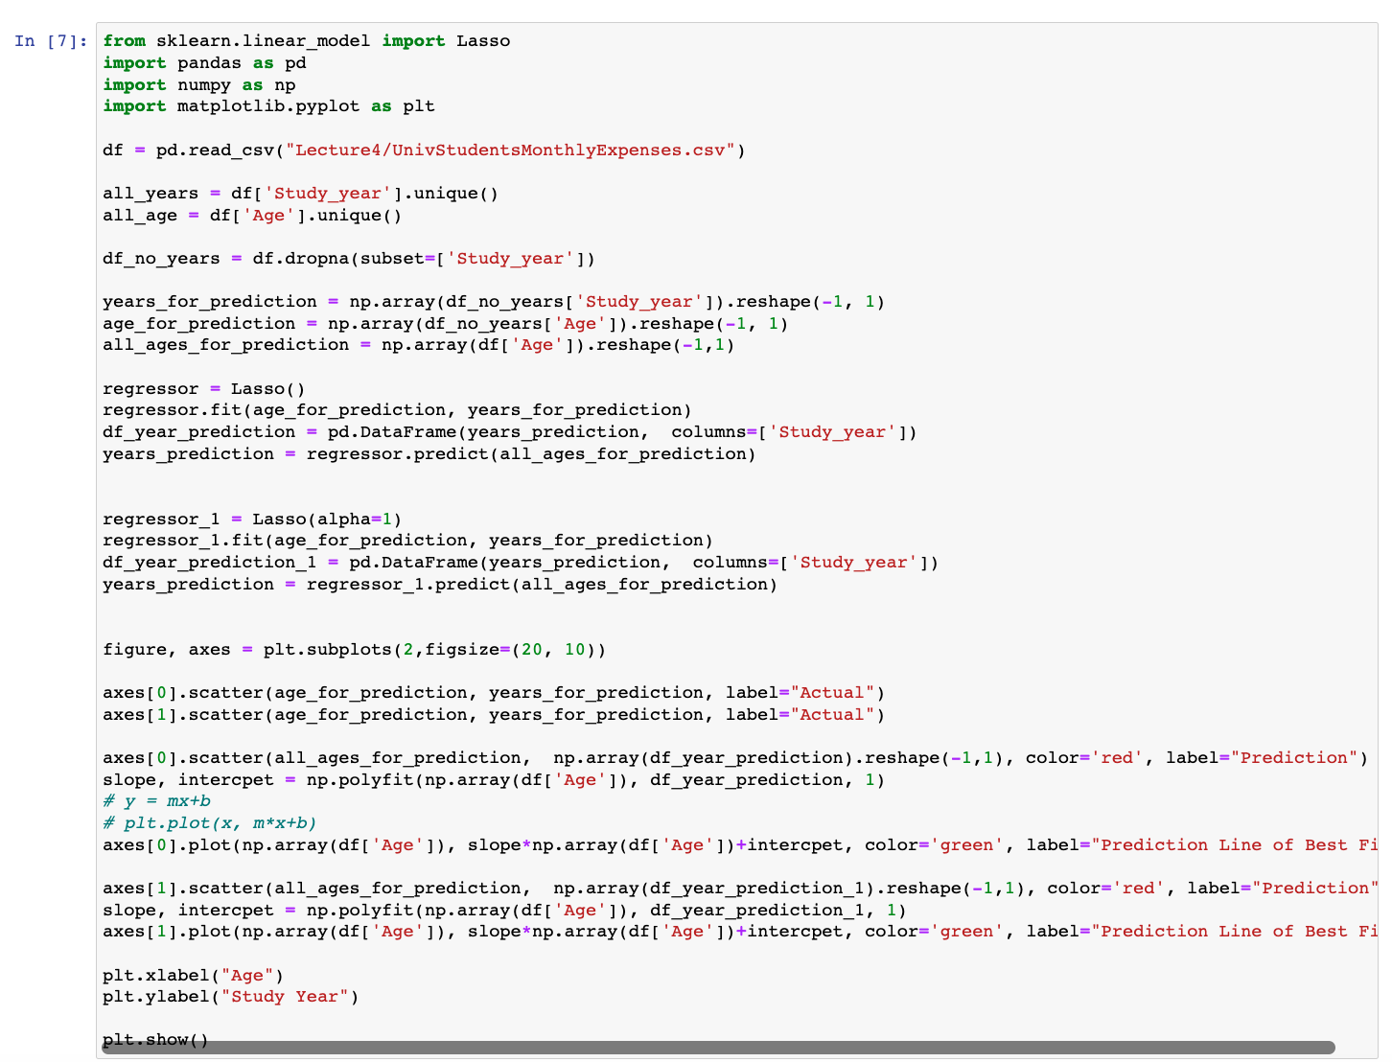
L1 Regularization

Slide 31
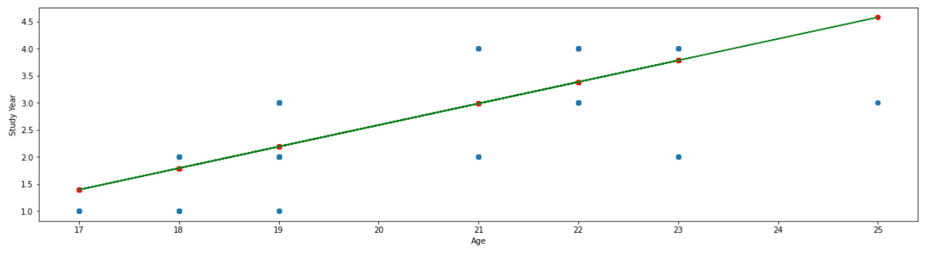
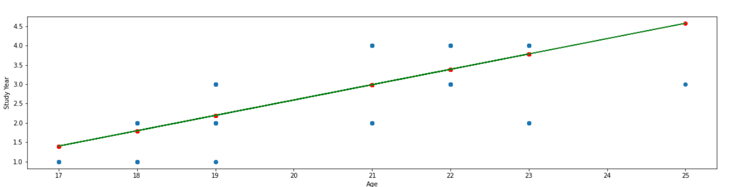
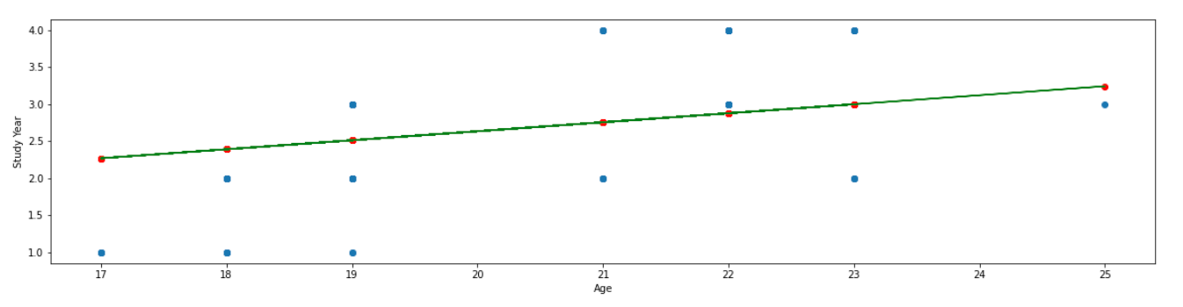
L1 vs L2 Regularization
How does standard Linear Regression (top) compare to L2 Regularization (middle) and L1 Regularization (bottom)?
Note: Linear Regression only uses one feature for prediction. Other prediction and ML algorithms consider multiple features

Slide 32
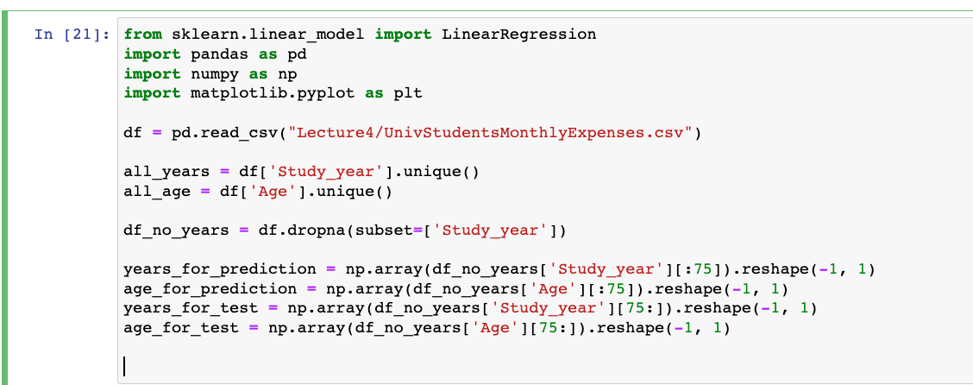
Testing
Recall from the beginning of this lecture that we can divide data to be used for testing and validation.
Let’s divide up our ‘age’ and ‘study_year ‘ so that we can have a subset of data to test our Ridge, Lasso, and Linear Regression predictions

Slide 33
Testing
Here, I’m using the first 75 values to create my regression (years_for_prediction, age_for_prediction) and the rest of the values for testing(years_for_test, age_for_test)

Slide 34
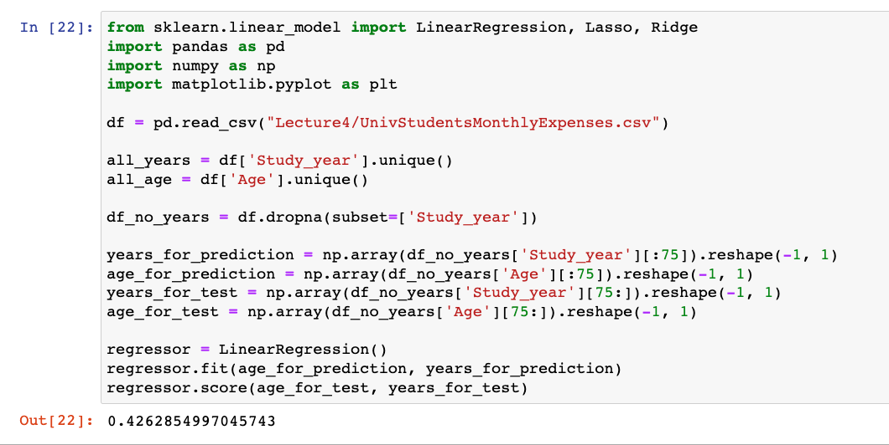
Testing
The “score” function, will give us a percent accuracy of our regressor

Slide 35
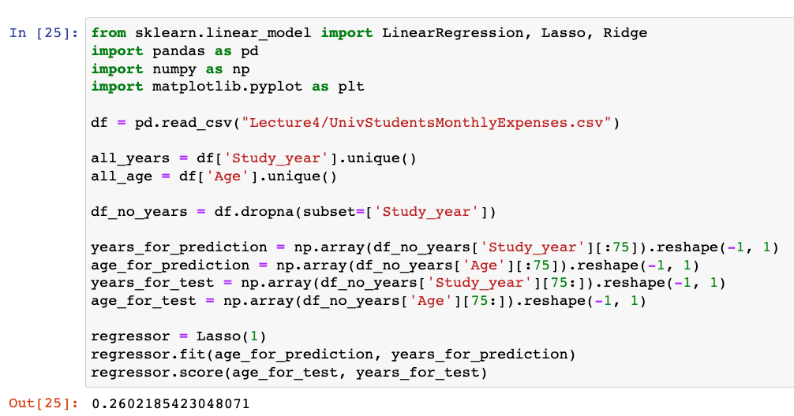
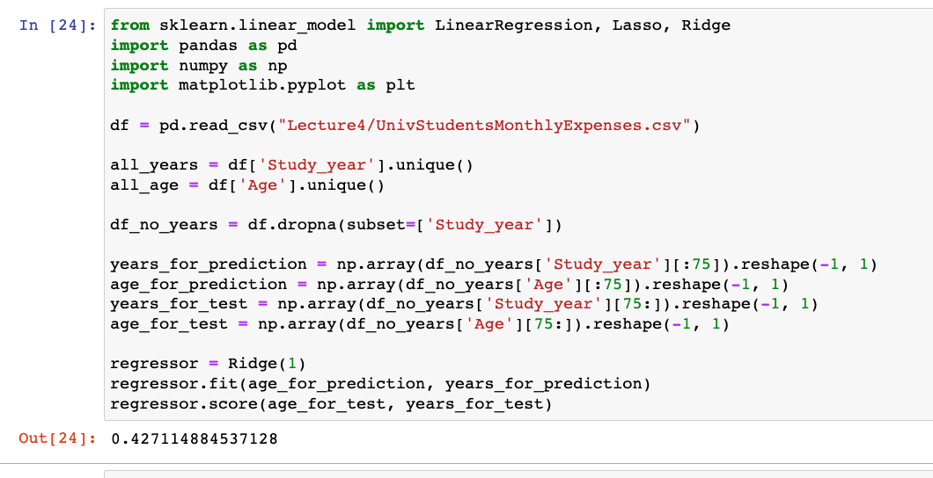
Testing

Slide 36
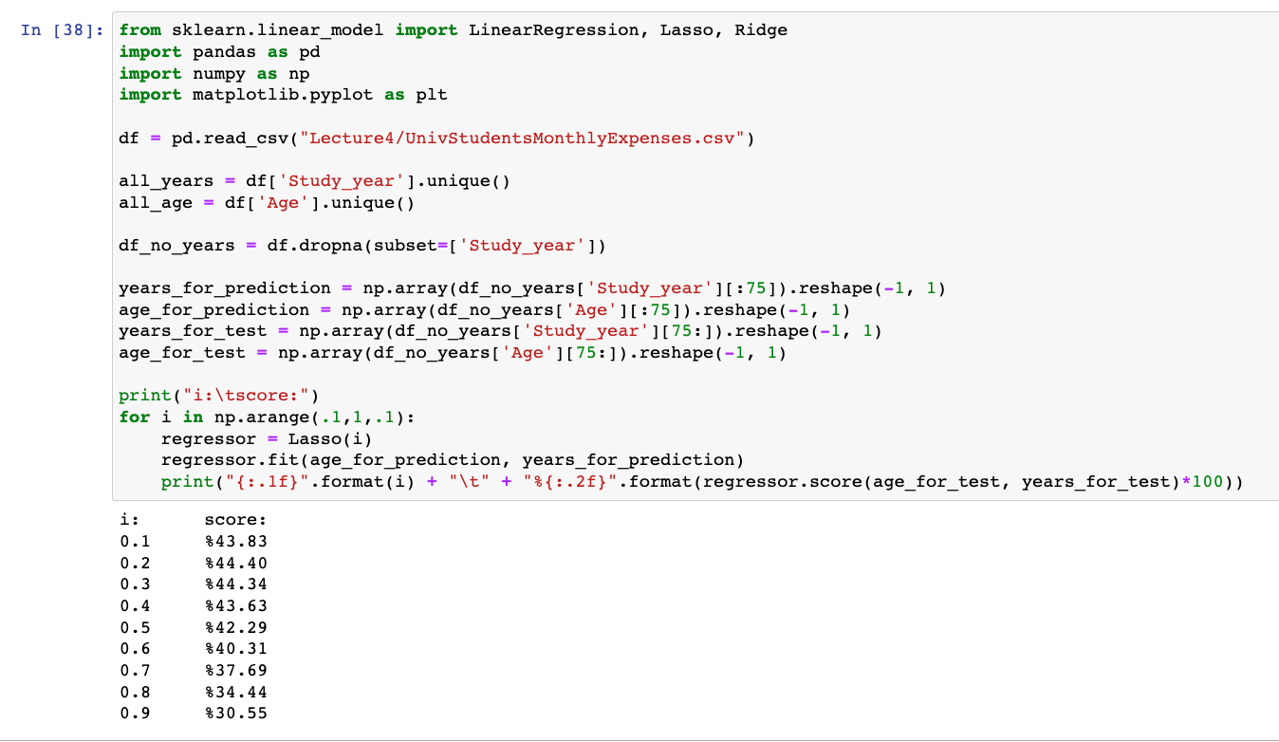
Testing
We can try different regularization parameters to try to achieve a better score
Note: np.arange is similar to the range function but accepts floats

Slide 37
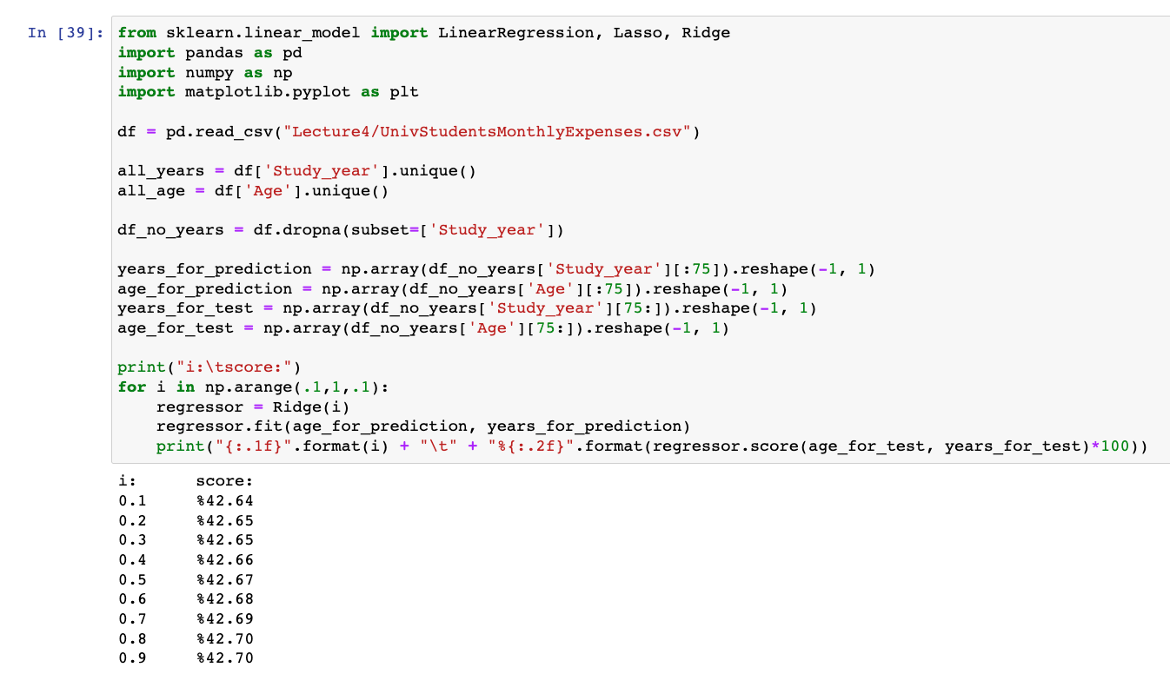
Testing
If you can’t get a good score, then there isn’t a strong enough correlation between the feature(s) you’re using to make predictions and the feature or outcome you’re trying to predict

